Slide 1
PLACEMENT PORTAL
Project Guide
G.shanthi Kumari
Presented By
Team-17
Dhanalakshmi. L
Reethika. T
Posi lakshmi. M
Ravitejaswani. M

Slide 2
ABSTRACT
The project is aimed at developing a website for the “PLACEMENT PORTAL” of the college. This website can be used by Placement Officers in the college to manage the student information with regards to placement. Student logging should be able to upload their personal and educational information . The key feature of this project is that it is one time registration enabled. Our project provides the facility of maintaining the details of the students in a database so that the companies obtain a suitable means of employment. It reduces the manual work and consumes less paper work to reduce the time. Visitors or company representatives logging in may also access/search any information kept by students.

Slide 3
BASE STUDY
In existing system all processes are handle manually. The admin should refer all records kept for years ago to simply know about number of users. The interface of student and admin is maximum which makes the system time consuming.
The searching and updating of student data are major problem in existing system. The proposed system provides automation in all the processes like registration, update and searching.

Slide 4
Cont..
This study describes the idea about users and their authority this makes the application more easy and attractive
There are mainly two users:- TPO(Admin) and student. The admin is the master user, he has more number of priorities than other users.
The study also describes the idea of automated email sending to eligible student.
The process of feeding information about upcoming company by the TPO is also described

Slide 5
PROPOSED SYSTEM
In the proposed system the student who got registered can directly get the information regarding placements and training courses which are posted by TPO and HOD in the portal.
The Student must enter the full information and upload the academic certificates, photo & signature, resume, E-Pass documents, and other certificates.
The Student can ask any queries regarding placements and drives via comments.

Slide 6
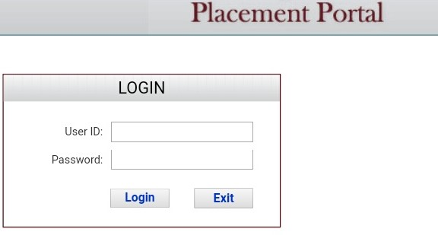

Slide 7
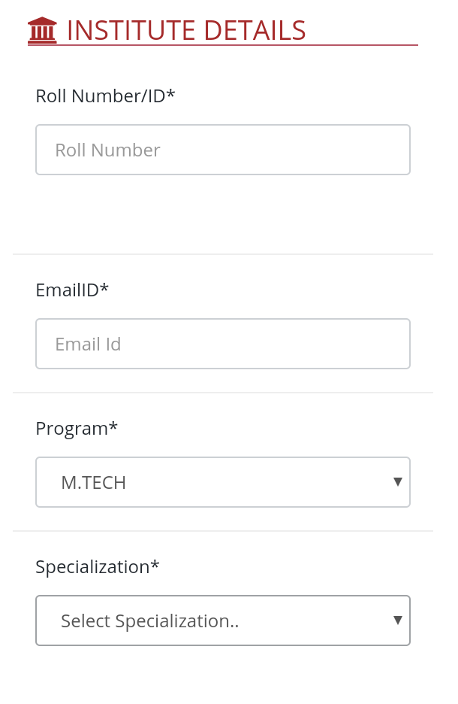
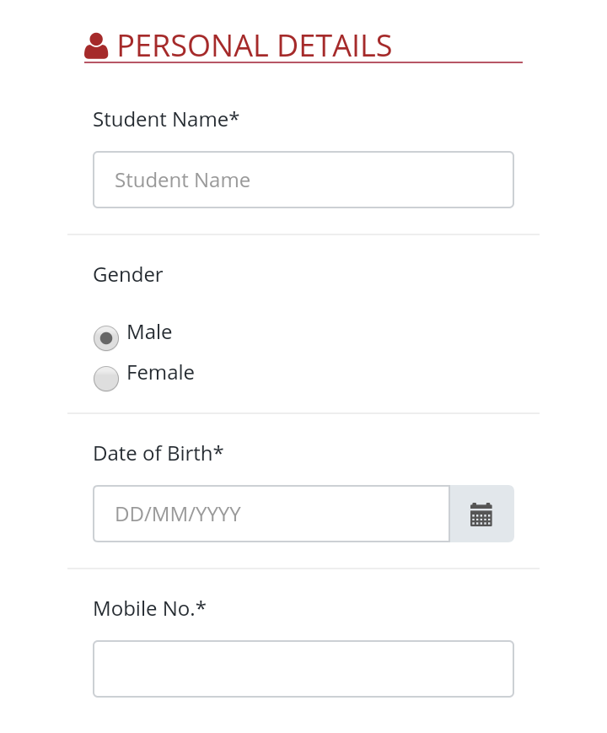
REGISTRATION FORM

Slide 8
EXISTED SYSTEM
In the existing system we need to search for placements on different websites and we may not know whether it is correct or not so there are chances of misguiding students.
In website admin may or may not have full details of every student.

Slide 9
THANK YOU

